Slide 1
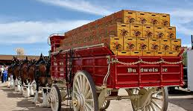
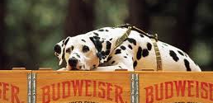
Competitive Intelligence Presented by: Jasmine Coleman
Budweiser

Slide 2


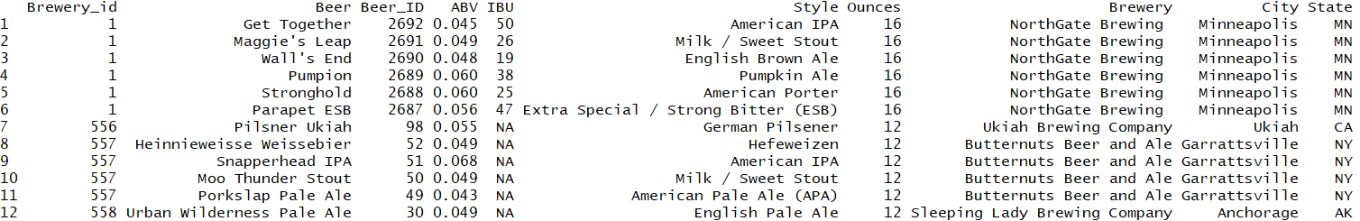
Data Overview
Beer Information
Brewery Information
2410 US Craft Beers
ABV: Alcohol by Volume
IBU: International Bitterness Units
Style
Ounces
Original brewery
Missing Values
558 US Breweries
City
State
Notes:
We are looking at a combo of beer and brewery info to get a better understanding of the competitive landscape and what markets we should target

Slide 3
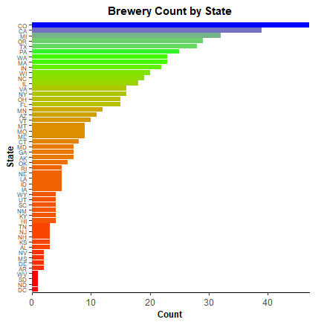
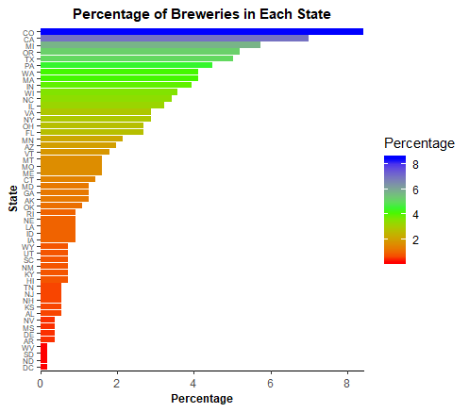
US Brewery Locations
Notes:
To start, we wanted to get an idea of how many breweries were in each state. At quick glance we can see that that number ranges from 47 in states like Colorado all the way down to several states only having 1 brewery including the District of Columbia.

Slide 4
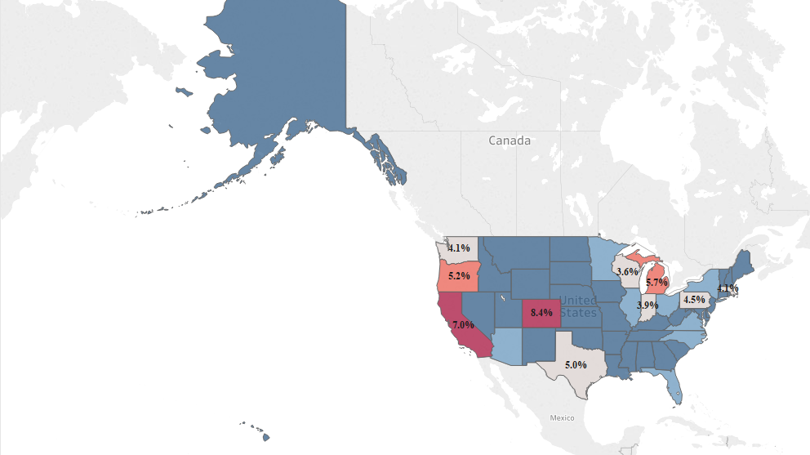
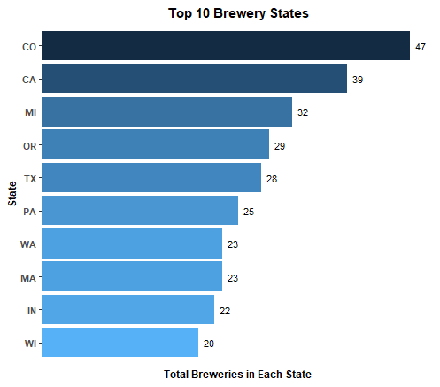
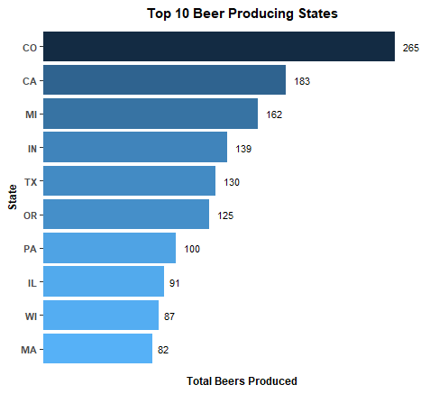
US Brewery Locations & Beer Production Volume
51.6% of US Breweries are located in 10 States
Notes:
To get a better understanding of which markets we should focus on we looked at the top 10 states (housing) with the most breweries. Interestingly enough, we found that10 states housed over 50% of all US breweries.

Slide 5
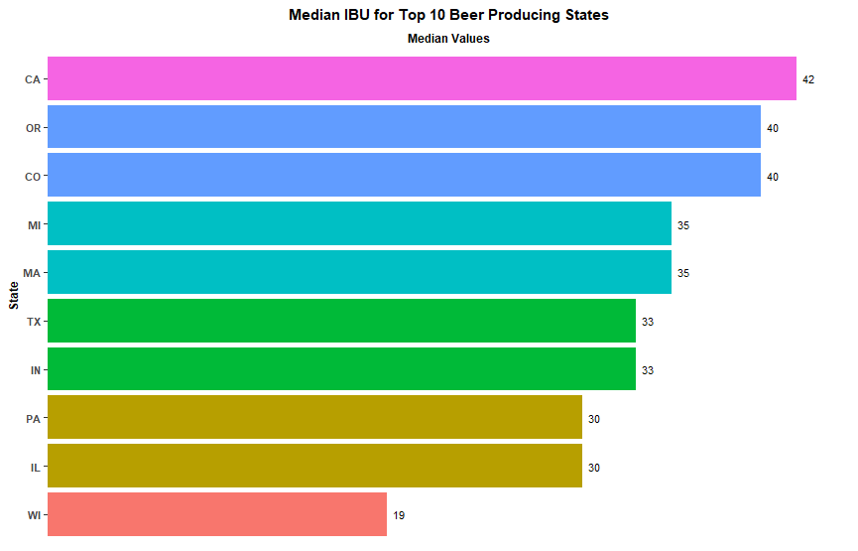
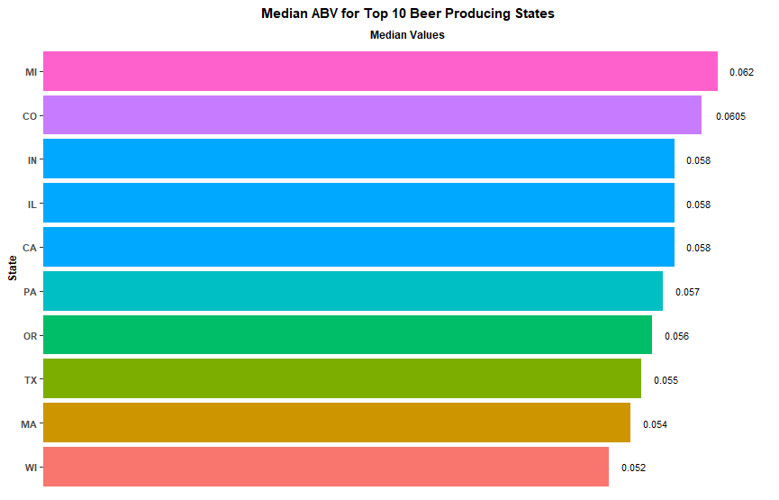
Beer Stats
Notes:
ABV ranges from 0.001 to 0.128 but the majority of beers range btw .052 and .062 ABV with CO producing highest at…
IBU ranges from 4.00 to 138.00 but the top 10 states range btw 19 and 42 … with OR producing highest at…
Max ABV: CO - 0.128
Max IBU: OR -138

Slide 6
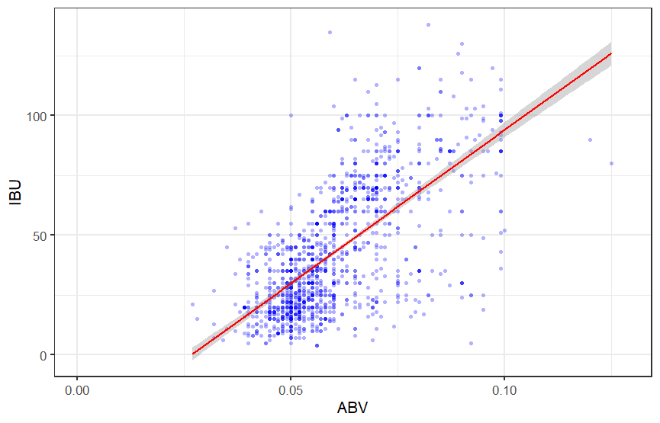
Bitterness vs. Alcohol Content
Alcohol by Volume
Min. | 1st Qu. | Median | Mean | 3rd Qu. | Max. | NA's
0.00100 | 0.05000 | 0.05600 | 0.05977 | 0.06700 | 0.12800 | 62
International Bitterness Units
Min. | 1st Qu. | Median | Mean | 3rd Qu. | Max. | NA's
4.00 | 21.00 | 35.00 | 42.71 | 64.00 | 138.00 | 1005
Notes:
IBU: Bitterness
ABV: Alc. content

